Slide 1
Intro to the Library’s Mobile Medical Apps
MD
Clerkship Director, Medical Informatics Education
Regional Campus FSU COM
Nancy Clark, M.Ed.
Medical Informatics Director
Terri Johnson, MSLIS, AHIP
Medical Informatics Librarian
Spring 2017

Slide 2
Goals For Session
Identify medical apps provided by the Maguire Library and select what you want
Identify the resources available in mobile format on the mobile library site
Register for and install apps to the mobile device*
Established users—renew subscriptions or switch devices
Get help if needed
*Apple iOS and Android devices

Slide 3
Handouts
PowerPoint
Checklist for writing down usernames and password for each resource
Evaluation

Slide 4
What do you want to do?
Loading apps on your device for the first time?
Renew your apps?
Switch apps to a new device?
Load an additional device with your apps?
Update your current apps?
Set up icon for mobile library site?
Notes:
Everyone has different goals for the session. Therefore, we will not be lock stepping thru this. Each person will need to decide, consult with a helper to get the correct set of instructions, and follow those to accomplish your goals. If you need help, just raise your hand.

Slide 5
For This to Work…
Know your email address
Know any usernames and passwords you may have set up at Epocrates/others in the past
iPhone/iPad users:
Must have an Apple account
Know your Apple ID username and password
Android users:
Must have a Google account and know …
Notes:
Note: Starting September 2016 faculty will need to use their FSUID to access resources from off-campus. If they don’t know their FSUID contact their local/regional campus IT person. Instructions are on the FAQ page located on the library website.

Slide 6
App vs. Mobile-Friendly Website
Apps
Run in airplane mode
Download from App Store
Use anywhere
Fast
Some require registration, annual renewal, updating
Mobile-Friendly Website
Responsive to small smartphone screen
Require cellular data or wifi connection
Can be slow
If off campus, must log in to library to use

Slide 7
Mobile Apps
Notes:
Remember apps are downloaded on your device and do not require wifi but you have to keep updated.

Slide 8
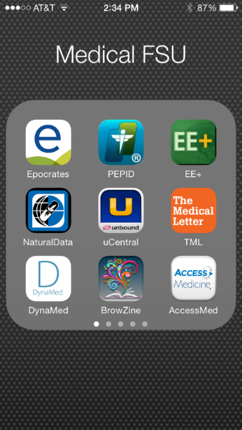
What Apps Currently Available
AccessMedicine
BrowZine
DynaMed Plus
Epocrates
First Consult- (Apple only)
Natural Medicines Database
Pediatric Care Online/Redbook
PEPID
Prescriber’s Letter
The Medical Letter
uCentral
Notes:
PEPID, uCentral, Epocrates, and Dynamed have specifically friendly iPad versions as well. Any iPhone app works on an iPad, but the iPad friendly apps are easier to use and better utilize the nice real estate of the iPad screen

Slide 9
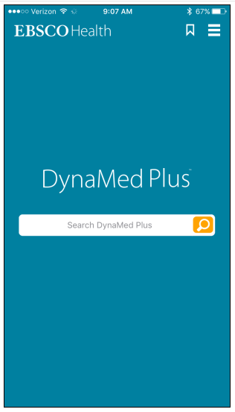
DynaMed Plus
Evidenced-based- most current
Disease/drug reference, with images
Calculators
Reviews of latest lit on each topic
Organized by type of question
ICD-9 & ICD-10
Levels of Evidence given
Has a separate tablet version and mobile-friendly website
Notes:
Dynamed has added drugs to their content, but from the evidence perspective.
The registration is very easy and you no longer have to get a serial number. Just go to the DynaMed Plus site, click on “Get the DynaMed Pluse Mobile App” on the left of the screen, put in your email, and they send you an activation link for the app you have downloaded.

Slide 10
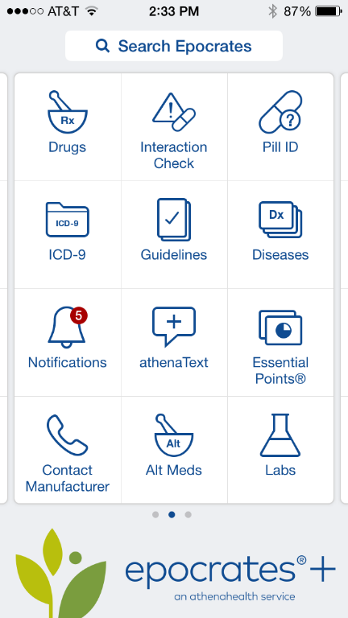
Epocrates
Rx= Drugs
Drug Interactions
Dx=BMJ disease ref
DDX *
Lab=lab manual*
Pill Identifier
ID= Infectious Disease antibiotics guide*
Tables
Calculators
ICD-9 & 10 codes*
Has a separate Tablet version and mobile friendly web site
Notes:
* Not on the mobile or regular web site but is on the app

Slide 11
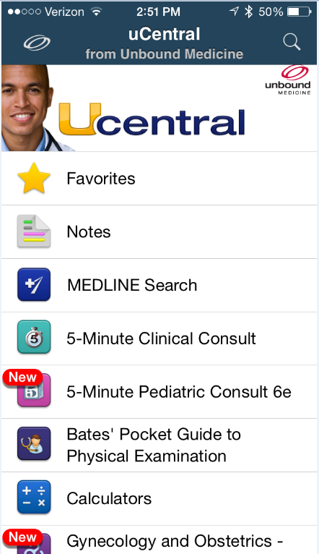
uCentral
5-Minute Clinical Consult
5-Minute Pediatric Consult
Bates’ Physical and Hx Taking
Calculators
Harriet Lane
Harrison’s Manual of Medicine
Johns Hopkins OB/GYN
Johns Hopkins Psychiatry
Johns Hopkins ABX Guide
Johns Hopkins Diabetes Guide
Johns Hopkins HIV Guide
Washington Manual of Medical Therapeutics
Medline search linked to CoM Journals
Has a separate tablet version
Notes:
The library is adding resources to this bucket all the time. This interface is very easy to use. (There is NO Mobile friendly uCentral site. YET.)

Slide 12
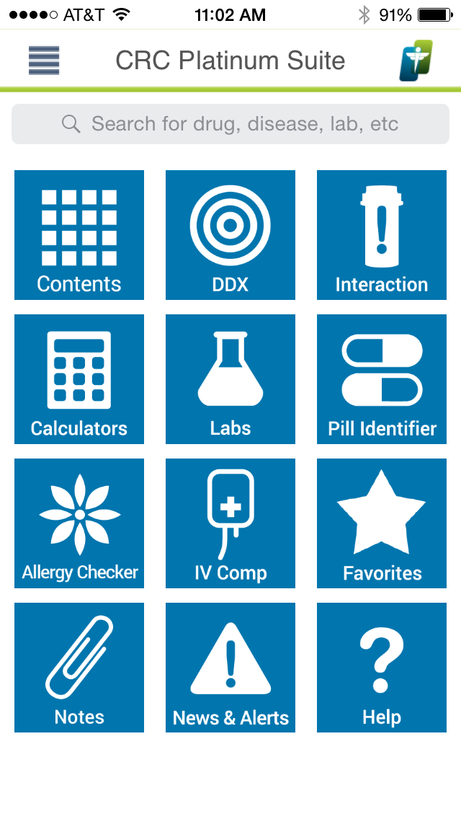
PEPID
CRC Suite
DDX generator
Disease
Drugs - interactions
Labs
Calculators
Clinical Rotations
Images
Medical Dictionary
Stedman’s
Has a separate tablet version
Notes:
Web site is not mobile friendly

Slide 13
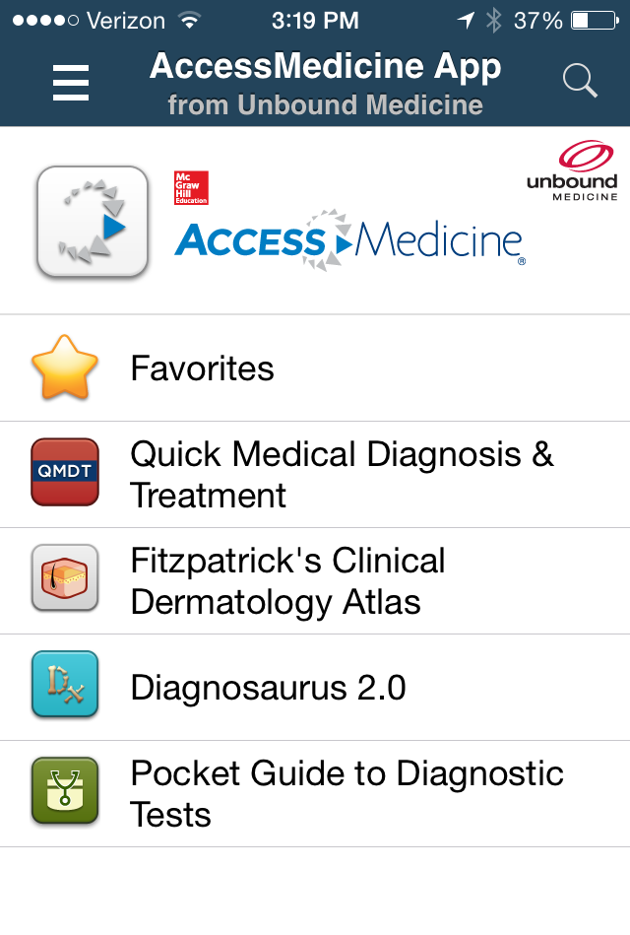
AccessMedicine
Quick Medical Diagnosis & Treatment
Fitzpatrick’s Clinical Dermatology Atlas
Diagnosaurus
Pocket Guide to Diagnostic Tests
Requires 90 day authentication
Has a separate tablet version
Notes:
The Mobile friendly web site may be a better choice because of the huge added content like all the Current Diagnosis & Treatment books and Harrisons, Fitzpatrick, Williams, Goodman & Gilmans, etc. The link to their mobile-friendly web site is in the Mobile Library site. However, this app is developed by Unbound and is very user friendly. The images in Fitzpatrick are excellent.

Slide 14
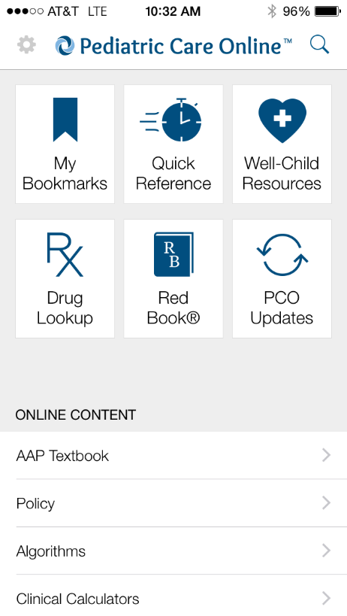
Pediatric Care Online
Content includes Red Book
Quick Reference and Drug Lookup content resident offline.
Some content linked to online resources
Not full website content (has mobile-friendly site)
Notes:
From the AAP this app contains only part of their web resource, but does contain the highly respected Red Book. There is a separate Red Book app.

Slide 15
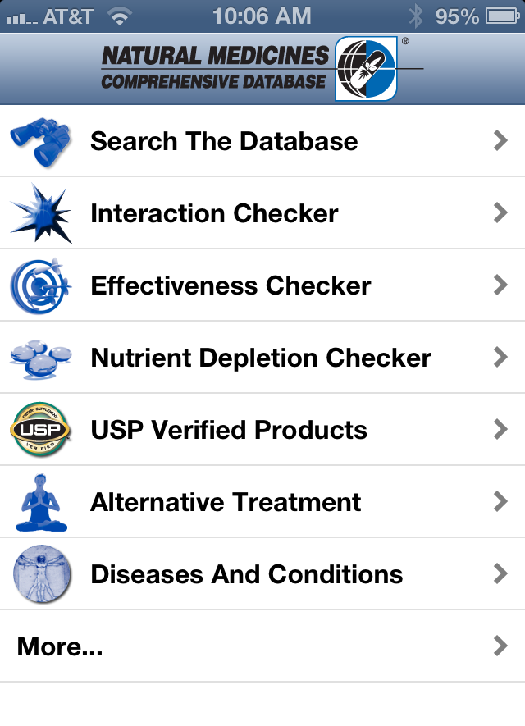
Natural Medicines
Alternative and complementary resource
Interactions with Rx drugs and Alt meds
Effectiveness of alt therapy/meds by Dx
Prescriber’s Letter app works with same username
Has a separate tablet version
Notes:
The interaction checker will look at all the ingredients of the Alt med, like Centrum Silver and a Rx drug. Airborne and Rx drugs like warfarin…..
Prescribers Letter, a nice journal with helpful medication news, also comes with this registration. It is a separate app.
[They are coming out with a mobile friendly web site, but ETA unknown.]

Slide 16
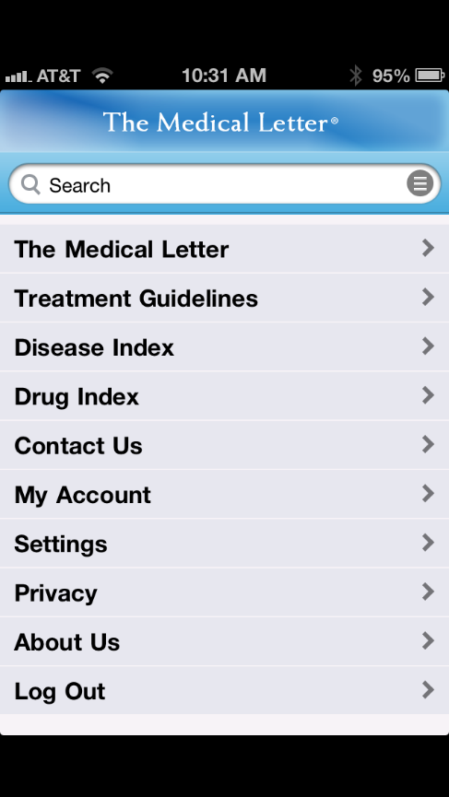
The Medical Letter
Read Journal Issues in PDF
Search old articles by
Drug, Condition or Treatment Guidelines
Better for tablet than smartphone
Address: CoM Address
Username: CoM email
Password: Letters and numbers (PEPID rules)
Notes:
Thanks to an observant student, we now realize you can access Dr. Patrick’s favorite journal on the Mobile Device. No mobile friendly web site, just the app.

Slide 17
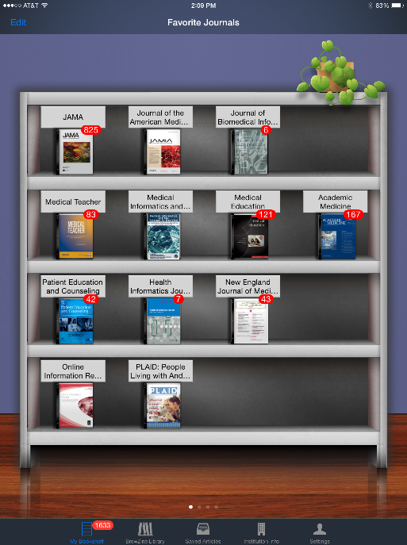
BrowZine
Journal e-reader
Select most FSU COM Journals to read
Look like journals
Alert you to new articles
Allows saving articles
Desktop version now available
Notes:
Desktop version will sync with mobile app. You can sync your account smartphone to tablet.

Slide 18
Update Resource Content
Apps update automatically if on a wireless network
Content may or may not update automatically
Those that need manual updates:
PEPID, AccessMedicine, uCentral
Notes:
You should keep your mobile device updated to the latest operating system, and the apps updates as they appear in the App Store updates section. Old versions stop working. Then you have a mess.

Slide 19
Mobile-Friendly sites

Slide 20
Mobile-friendly Subscription Sites
AccessMedicine
ClinicalKey
DynaMed Plus
Epocrates Online
Essential Evidence Plus
JAMA Evidence
Pediatric Care Online (Red Book)
Ageline
Google Scholar
Psychiatry Online
Pubmed
SPORTDiscus
Thieme E-Book Library
Notes:
Here is a sampling of the mobile-friendly sites. All of these are listed on the Mobile-Friendly Websites tab on the mobile resources guide.

Slide 21
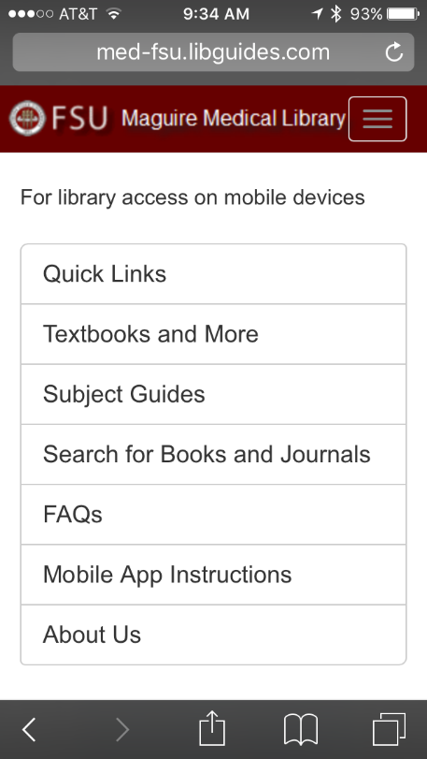
Library Resources Mobile-Friendly Sites
Ever-increasing number of resources are mobile-friendly
See instructions for creating shortcut to mobile resource guide

Slide 22
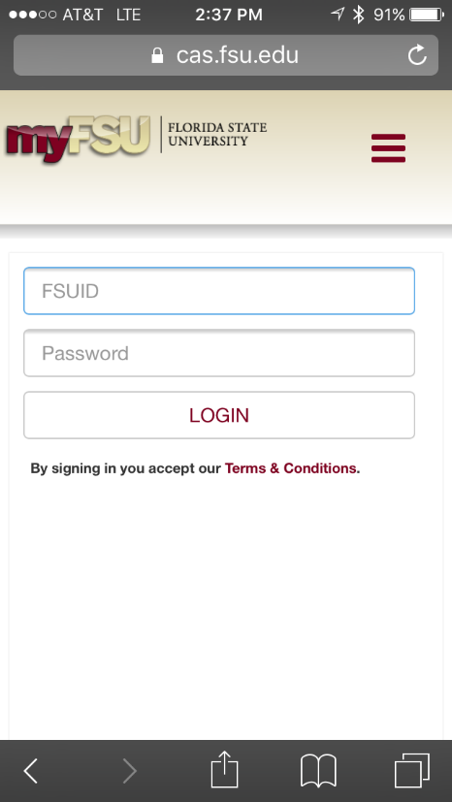
Off-Campus Access
Uses remote access just like regular library website.
Log in with FSUID and password
You will be prompted to off-campus access, if need
Notes:
The CoM username and password will no longer work starting September 1, 2016.

Slide 23
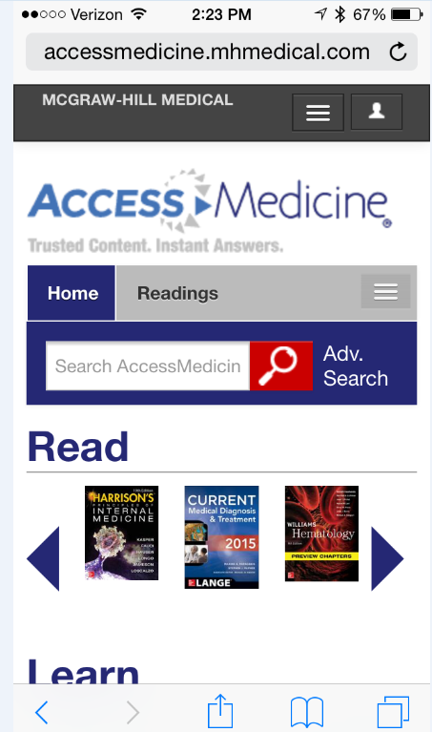
AccessMedicine
eBooks
Videos
Images
More content

Slide 24
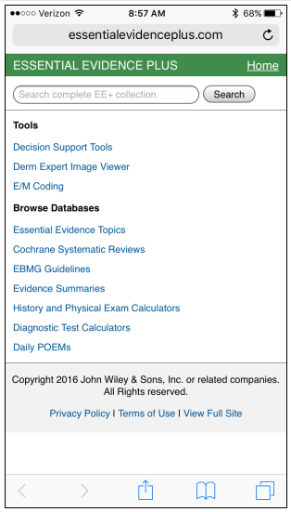
Essential Evidence Plus
EBM Resources
Cochrane Abstracts
InfoPOEMs
Decision Support Tools (Calculators)
Guidelines
E&M Coding Tool
Derm Expert
Mobile-friendly website
Notes:
One of the best EBM resources we have available. There are hundreds of useful clinical diagnostic, prediction and assessment calculators as well as guidelines and reviews of the latest research.

Slide 25
Free Mobile-friendly Medical Sites
CDC.gov
ePrognosis.ucsf.edu (estimates prognosis for elders)
The Absolute CVD Risk/Benefit Calculator (Framingham) http://chd.bestsciencemedicine.com/calc2.html
Notes:
Some highly useful and free medical reference or medical resource sites that have mobile friendly interfaces include these.

Slide 26
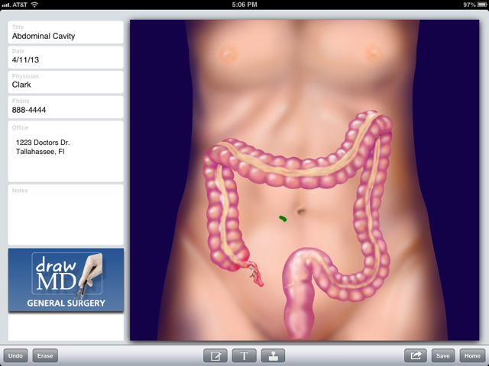
Selecting Other Mobile Apps
Notes:
This is a wonderful patient education app for the iPad that lets you draw and write on anatomical drawings and email to the patient. Can also show students procedures.

Slide 27
Suggested Free or Paid Apps
CDC Vaccination Schedule
AHRQ ePSS - USPSTF health maintenance recommendations
Medscape – drugs, disease, calculators, procedures reference
See Mobile Resource Guide for suggestions

Slide 28
Assessing Quality and Usefulness
iTunes does not discriminate medical apps into categories
100,000+ medical apps
Thousands of apps for patients vs healthcare professionals
Check Dx organizations for reviewed apps
FDA approving apps for Dx monitoring, screening, and management
Peck, Andrea. A solution to app overload. Medical Economics. Dec 25, 2011.
Notes:
New medically related apps are released every day. Finding the pearls in the ocean is difficult.

Slide 29
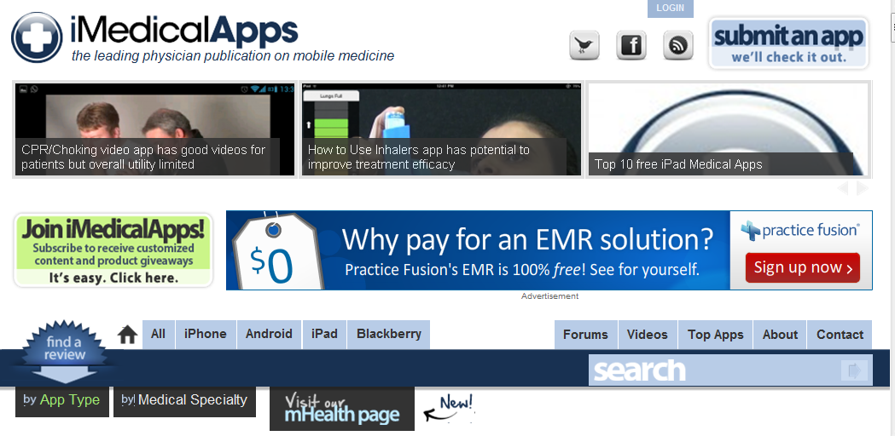
Keeping up with Medical Apps
iMedicalApps.com
Notes:
iMedicalApps web site has nice articles on new medical apps. We now have a RSS feed to iMedicalApps on the mobile guide. It is on the Free & Recommended tab.

Slide 30
As Mobile Apps Mature
Learn from your patients
Learn from peers and students
Ask what apps they find helpful
Include mobile apps recommendations into CME sessions on disease topics
Watch for more efforts to curate medical apps

Slide 31
Off-Campus Access
If clicking on a subscription site while off campus, you will be prompted to log in
Off-campus log in screen will appear
FSUID and password are now required
To get help with FSUID, contact regional campus IT support person.
Notes:
But first, let us make sure you know how to access the library web resources from off campus. Just because you can see the web site, does not mean you can actually pull up anything. Our web subscriptions verify that the users of our library resources are from FSU by means of what is called IP authentication. This is the internet address of the computer you are using to access the internet. Our campuses have a range of numbers that are assigned to computers that are logged on, and this range of numbers is provided to the vendors to use for authentication. Anyone using the library from off campus must fool the vendors (this is not illegal) by using their FSUID and password to sign in first, then using the resource through this server. When you click on any subscription resource from off campus, you will be asked to log in.

Slide 32
How This Works – New Registration
Online: Register for each Product
Create account
Get username and password
“Purchase” product for $0
On the device:
Find product in App Store/GooglePlay
Install
Sign in and download content over wireless
In 6-12 months: renew subscription online
Notes:
On the computer, register for the product if you have not already done so, and get a username and password.

Slide 33
Full Installation Instructions
http://med-fsu.libguides.com/mobile
READ and follow these step by step instructions
Every registration process is different at each product site

Slide 34
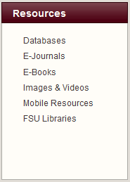
Links to Registration Sites

Slide 35
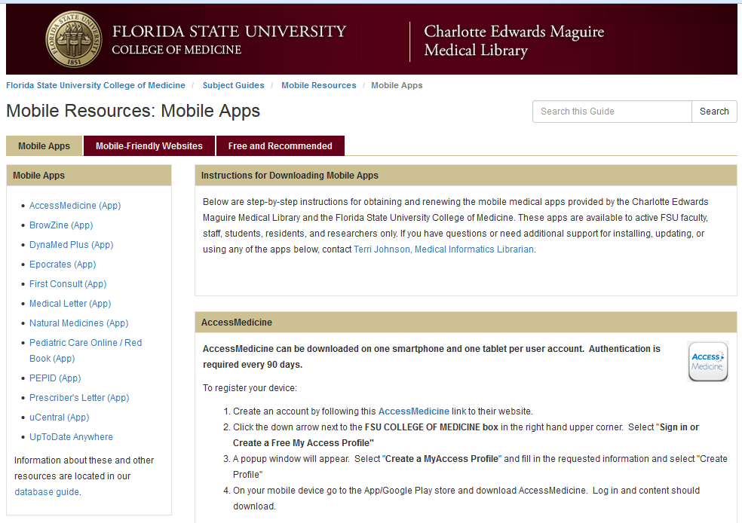
Mobile Resources Page
Notes:
Links are to the site where you register and set up a username and password, usually. You use these links to renew some of our subscriptions as well.

Slide 36
Password Management
Write down all numbers, userIDs and passwords you create on sheet provided…or
Save passwords electronically:
Password Management app now available from FSU COM – LastPass http://med.fsu.edu/?page=oit.lastPass
Notes in Outlook/phone
Take picture of Green Sheet
Notes:
FSU CoM has purchased an institutional subscription for all faculty/staff/students to use LastPass professional. This keeps your passwords all in one secure place, which you can access on an app on your phone, iPad and online. The iPhone app uses your thumb print.

Slide 37
Install Software
Read the Instructions
Raise Hand for help
We will circulate
Now the fun begins…
Follow us on Twitter for the latest updates @FSUmedlibrary

